Slide 1

Presentation On
JIRA
Submitted by: Neelam ma’am
University Roll No.: 1900290140009
Name:Archana varshney
Semester:6th
Date:-9/4/2022

Slide 2
JIRA
A Project contains issues; a JIRA project can be called as a collection of issues. A JIRA Project can be of several types.
For example – Software Development Project Marketing Project Migration to other platform project Help Desk Tracking Project Leave Request Management System Employee Performance System Website Enhancement

Slide 3
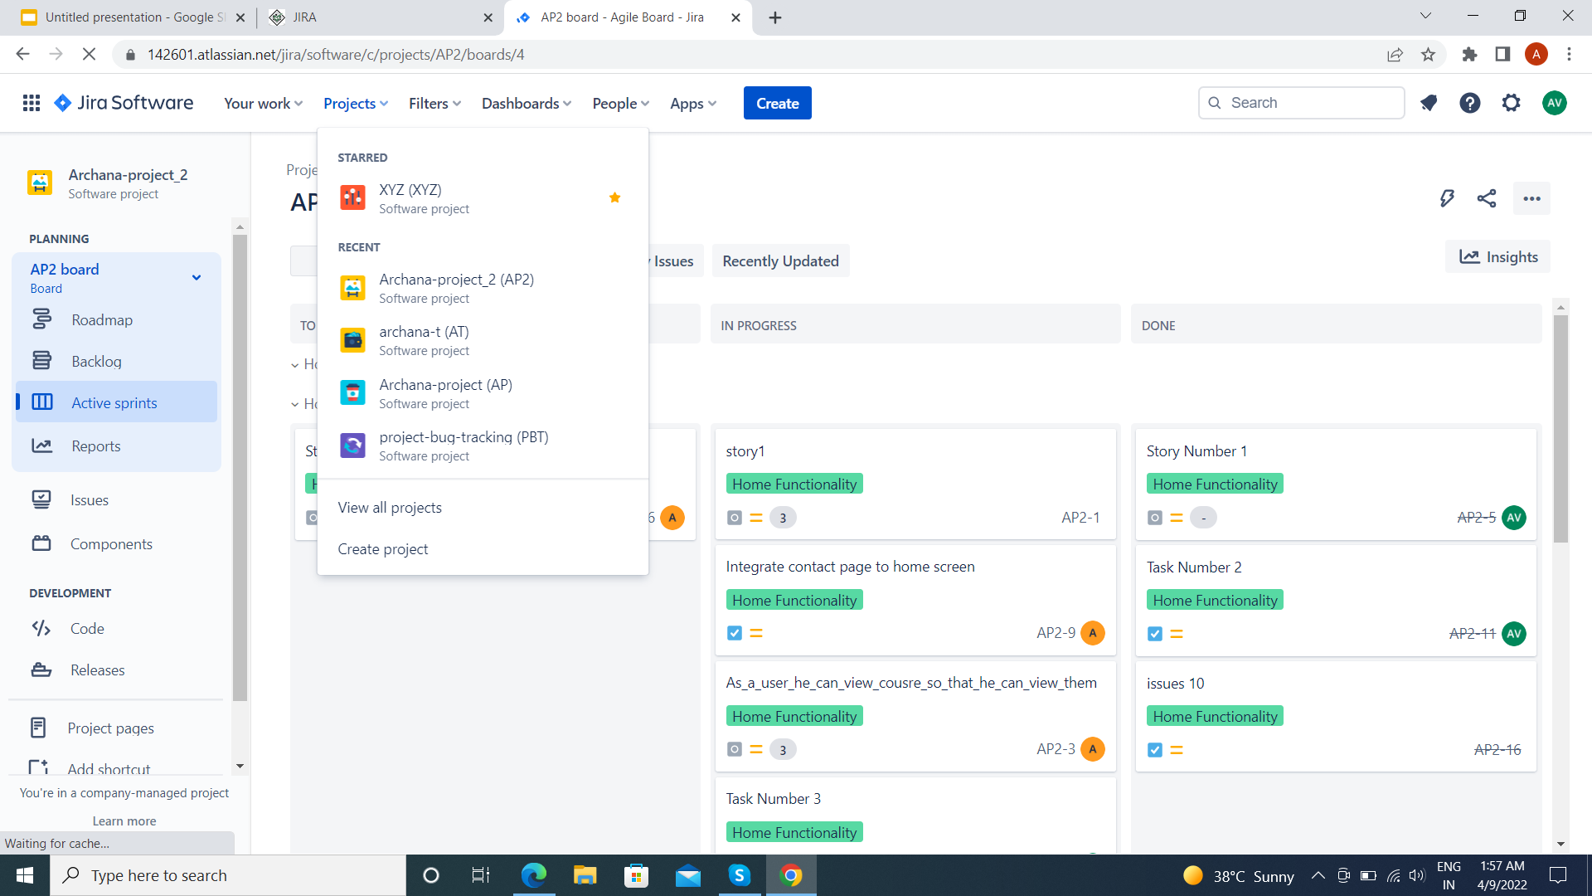
Create a New Project
To create a project, the user should login as a JIRA Service Desk Admin and then Click on Project Create Project. The following screenshot shows how to reach to the Create Project button from the Dashboard.

Slide 4
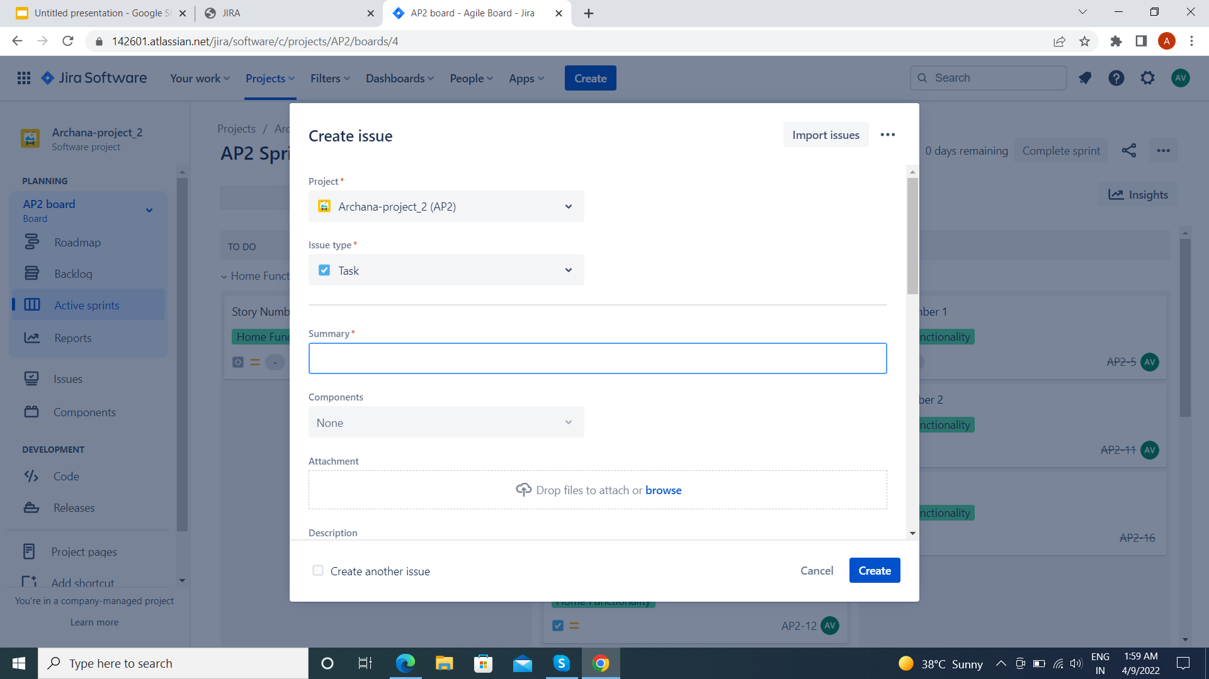
The following screenshot displays the type of projects available in JIRA. Once the type of project is selected, click on Next. The user will see the flow of the project based on the selection. Here, we have selected Basic Software development.

Slide 5
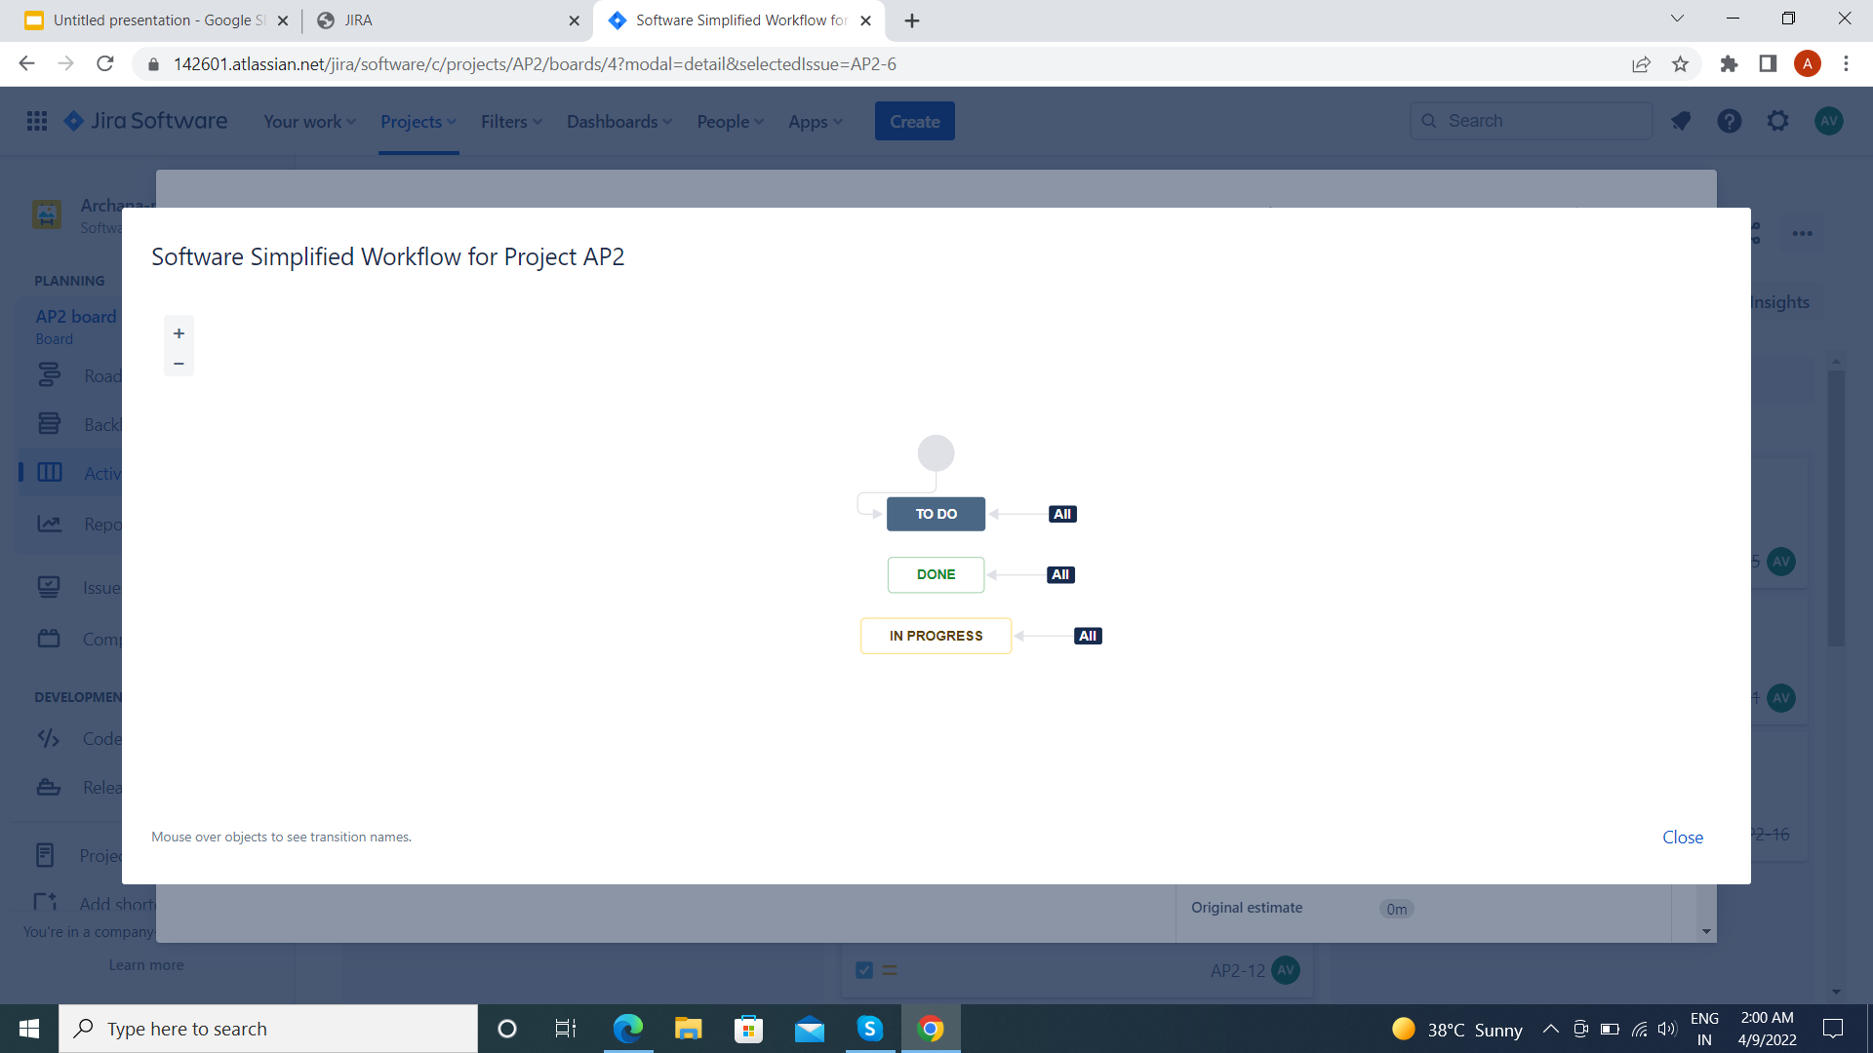
The following screenshot displays the available issue types and the workflow for the chosen project in the step mentioned above:

Slide 6
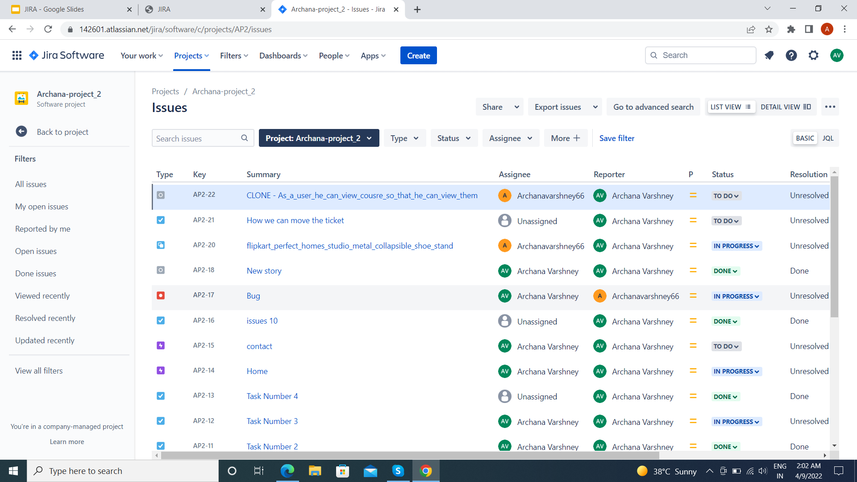
The page having issues will display. The following screenshot displays whether any issues are linked with a new created project.

Slide 7
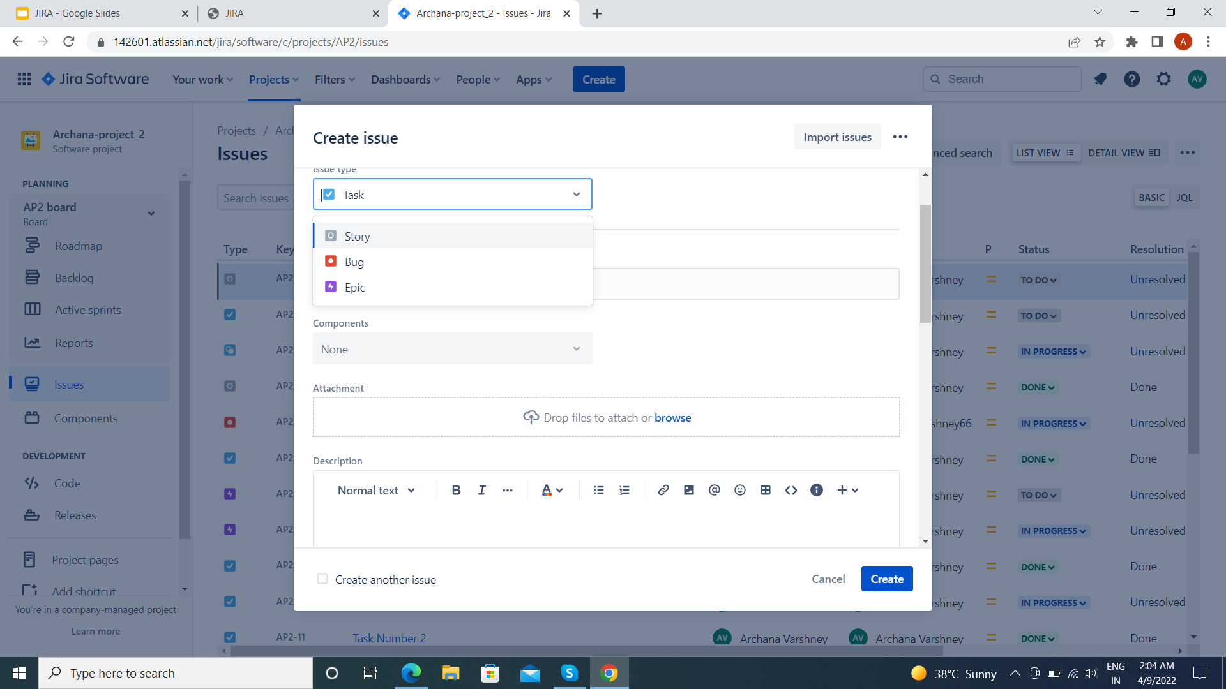
JIRA – Issues
The following screenshot shows the basic page and information of an open issue.

Slide 8
JIRA – Workflow
In JIRA, workflow is used to track the lifecycle of an Issue. Workflow is a record of statuses and transitions of an issue during its lifecycle. A status represents the stage of an issue at a particular point. An issue can be in only one status at a given point of time like Opened, To Do, Done, Closed, Assigned, etc. A transition is a link between two statuses when an issue moves from one status to another. For an issue to move between two statuses, a transition must exist. In a simple way, a transition is some kind of work done on the issue, while status is the impact of work on that issue.

Slide 9
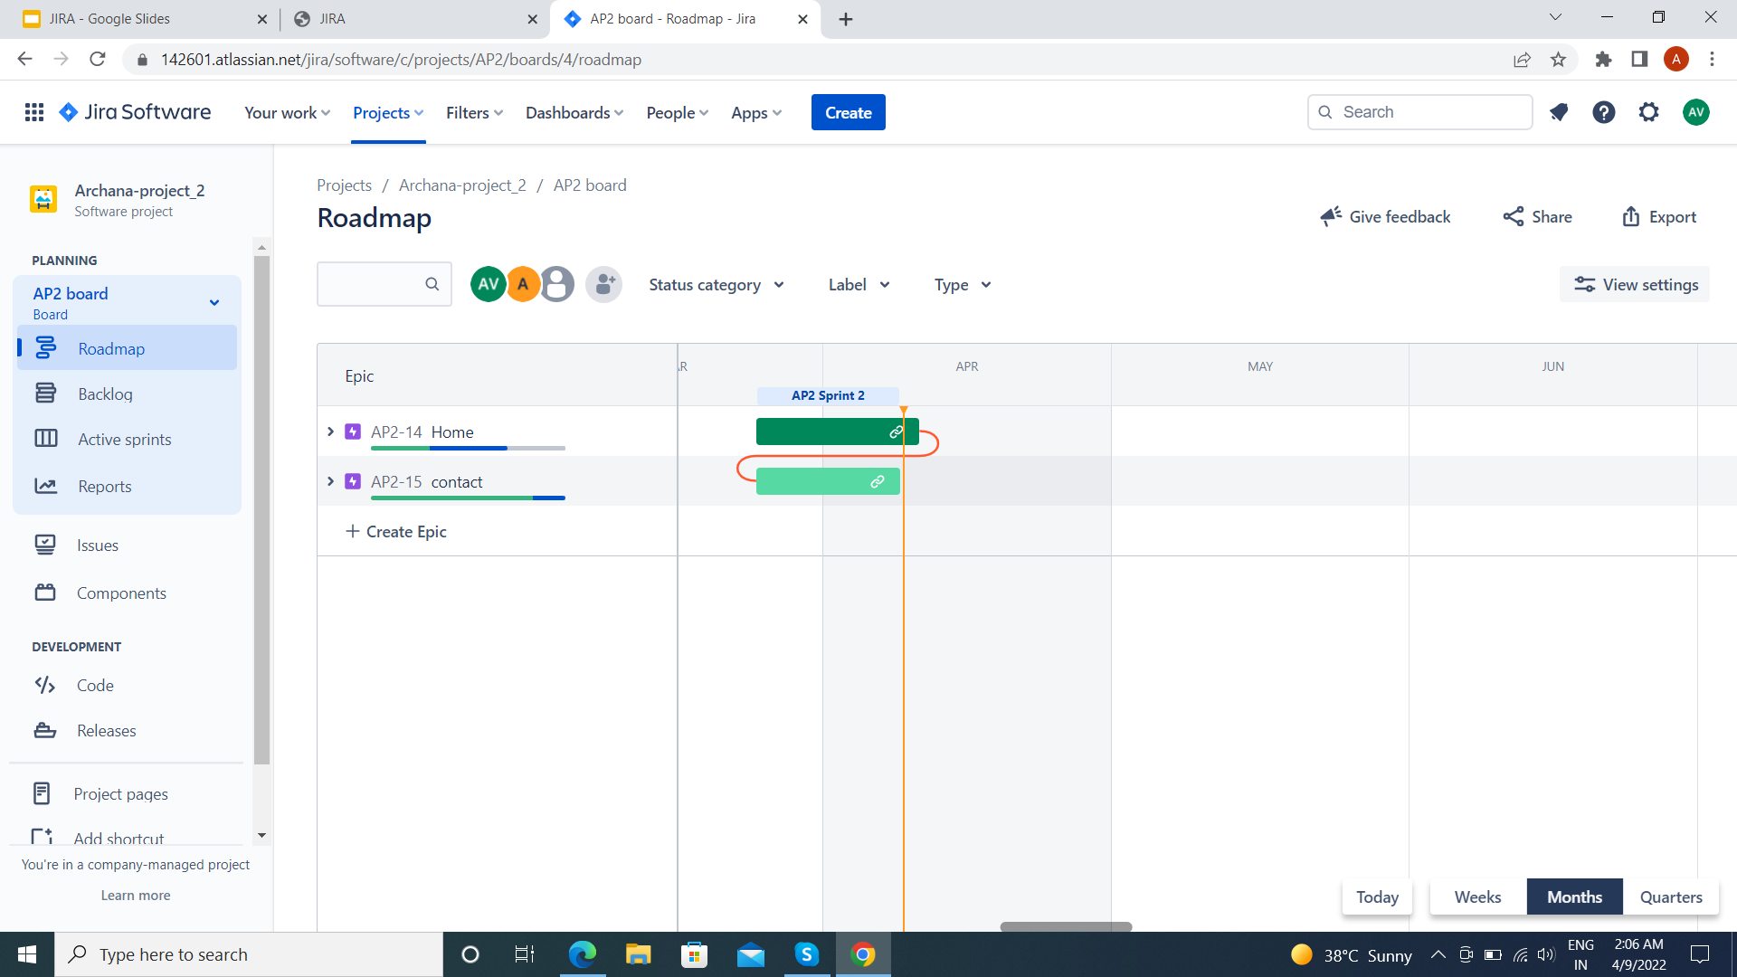
ROADMAP IN JIRA

Slide 10
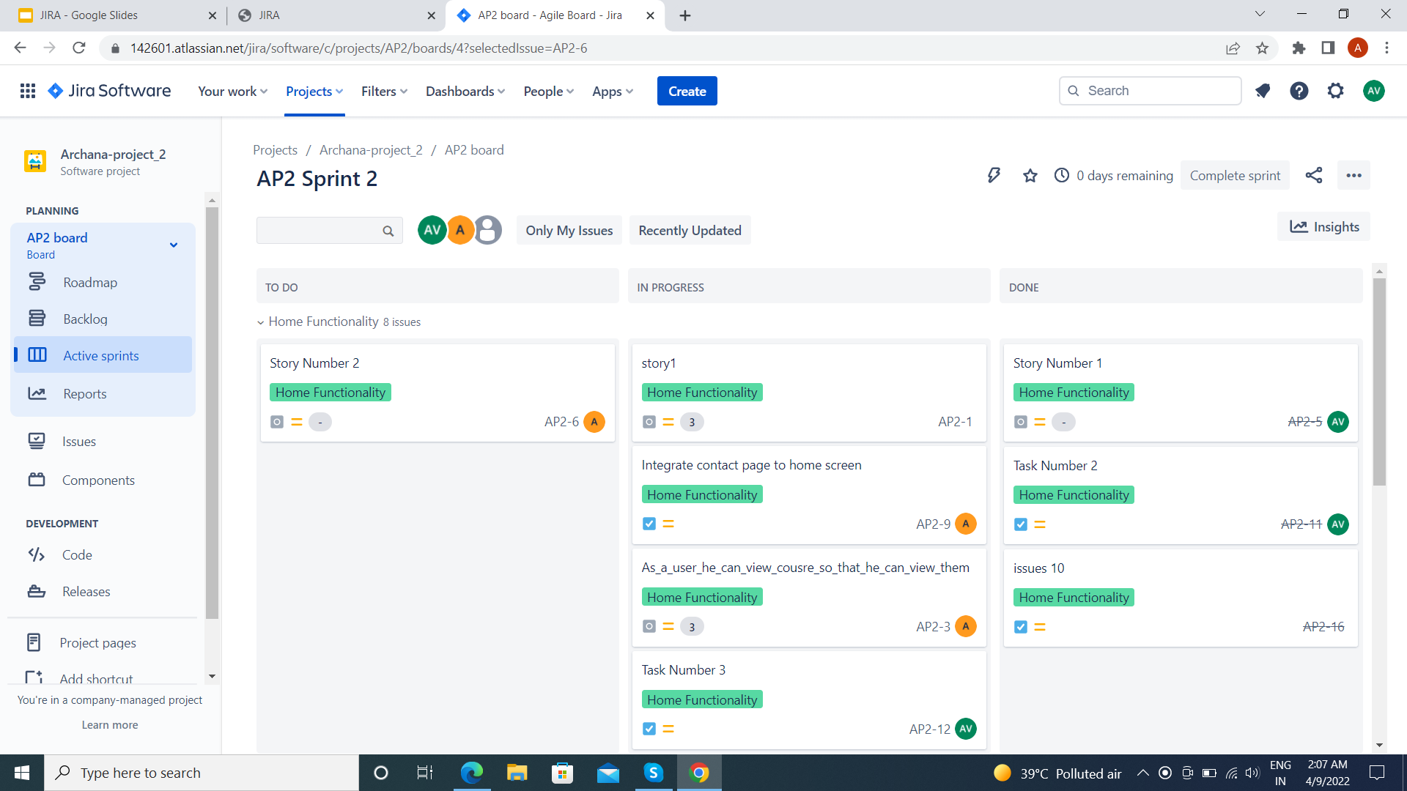
ACTIVE SPRINTS

Slide 11
THANK YOU

